Slide 1

EasyFit
Capstone Project Phase 1
Students: Din Salman & Eran Jehassy
Supervisor: Zeev Barzily

Slide 2
Agenda
The problem
Existing solutions
Our solution
Challenges
System architecture
Inteface
Diagrams
Testing plan
Conclusion

Slide 3

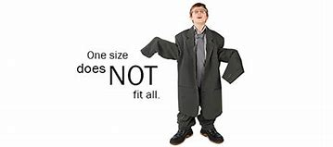
The problem
physically inactive lifestyles across the world is on the rise.
current applications often don't take into account individual factors like fitness level, medical conditions, availability and more.
The "one size fits all" approach common in most fitness applications is leading to reduced use and abandonment of exercise.

Slide 4
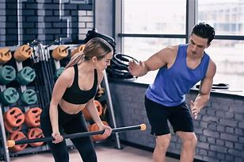
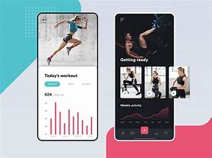
Existing Solutions
Classical personal trainer
Mobile fitness apps

Slide 5

Our Solution
An online personal trainer that knows your personal information, limitations, target and personalizes the workout for you specifically.
Give reports to track progress and get feedback every week.
Consult the trainer and change exercises if necessary.
Have a personal, tailored experience without the need to meet the trainer and have autonomy over your workouts – all the things one needs to stay consistent.

Slide 6

Challenges
Exercise presentation: we need to present the exercise in the application in a clear manner because the trainer is not there to help.
Security: The system saves some sensitive information – like medical issues. Security measures should be placed to make sure privacy is maintained.
User experience: Trainees already have a hard time having consistency with training. Therefore it is necessary to make sure the User Experience is smooth and frictionless.

Slide 7
Solutions to Challenges
Exercise presentation: Have a high resolution image of the exercise in two steps, and refer the trainee to a YouTube video showcasing the exercise.
Security: Encrypt the medical information before saving it to the database.
User experience: have a minimalistic UI. We follow the moto : “less is more”.

Slide 8
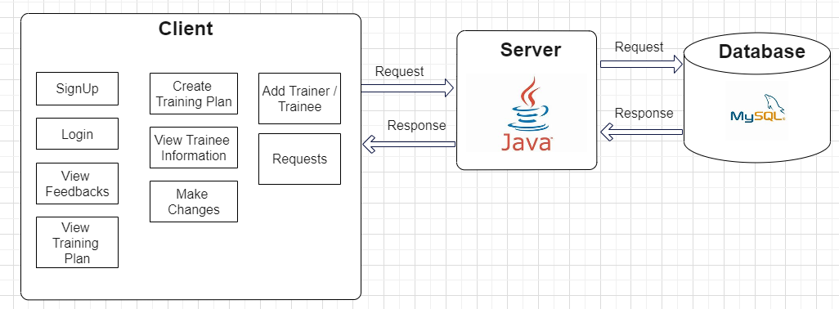
System Architecture

Slide 9
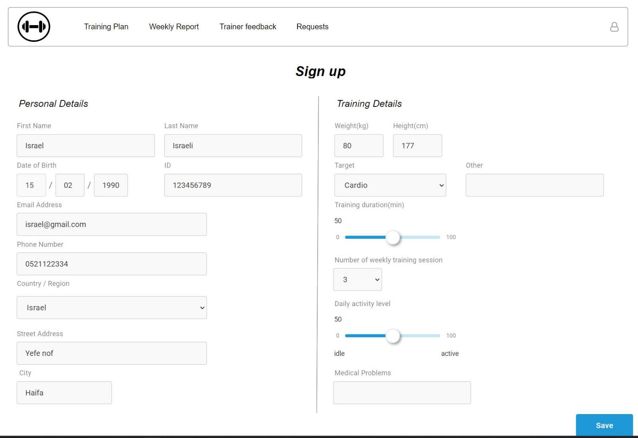
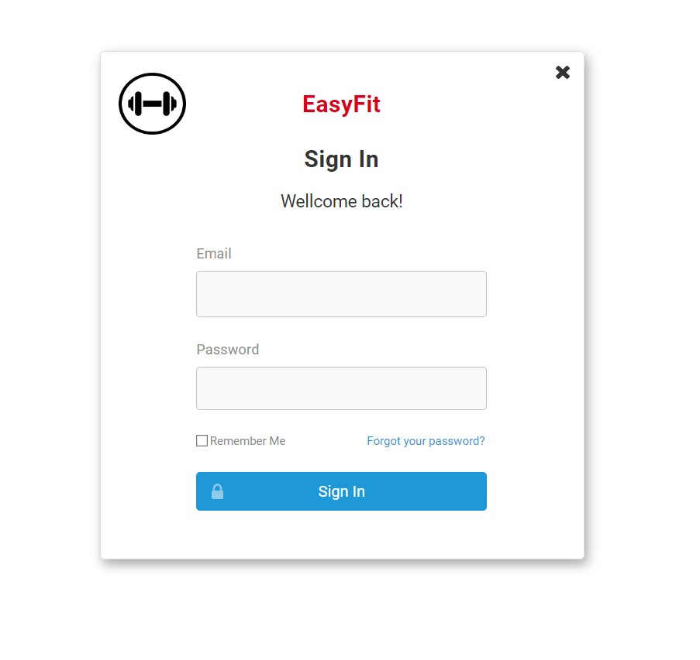
Interface

Slide 10
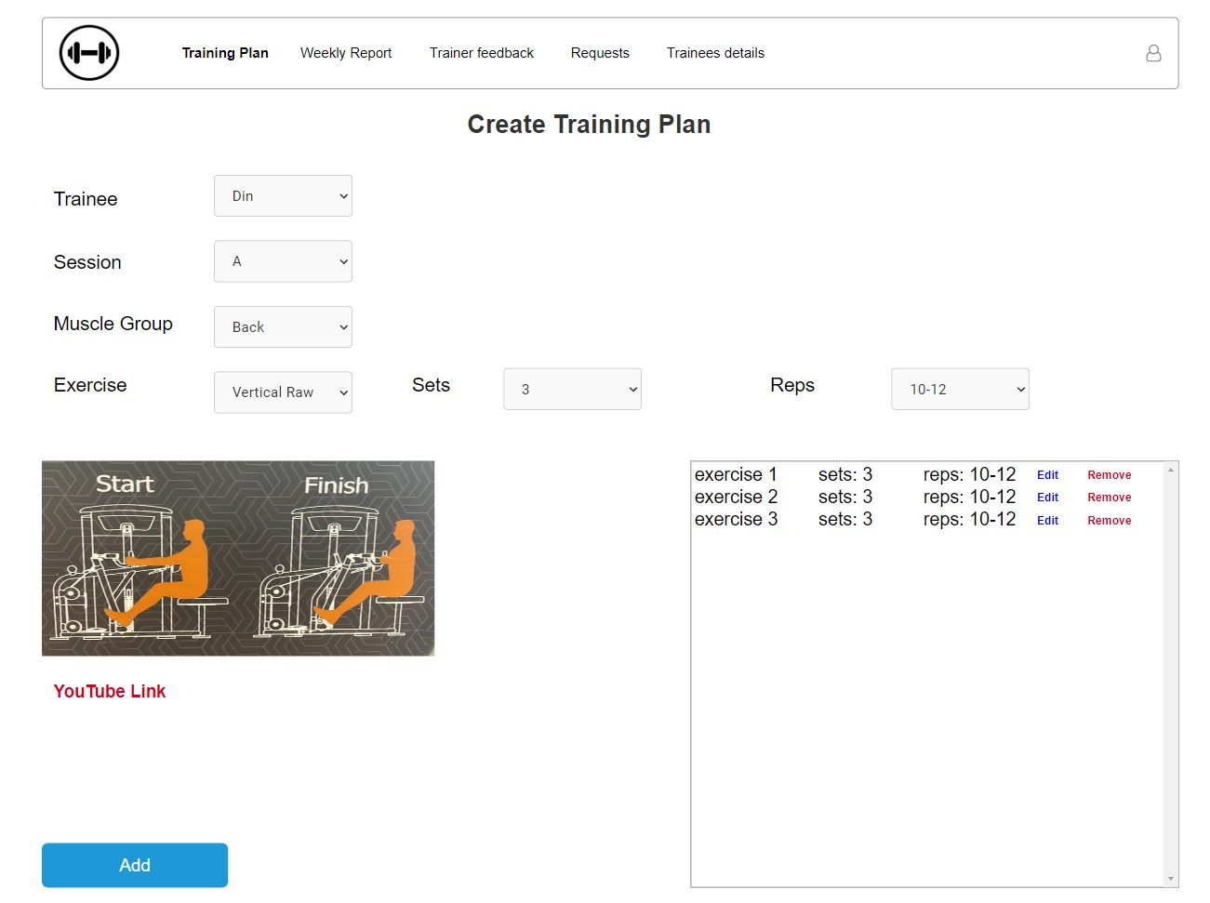
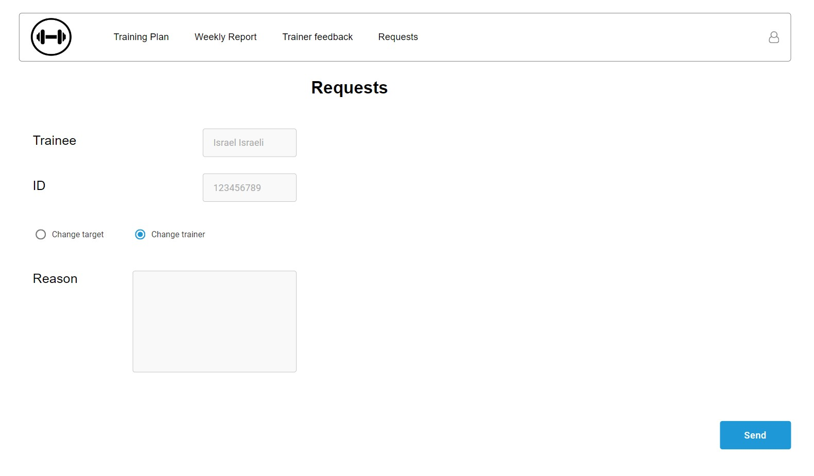
Interface

Slide 11
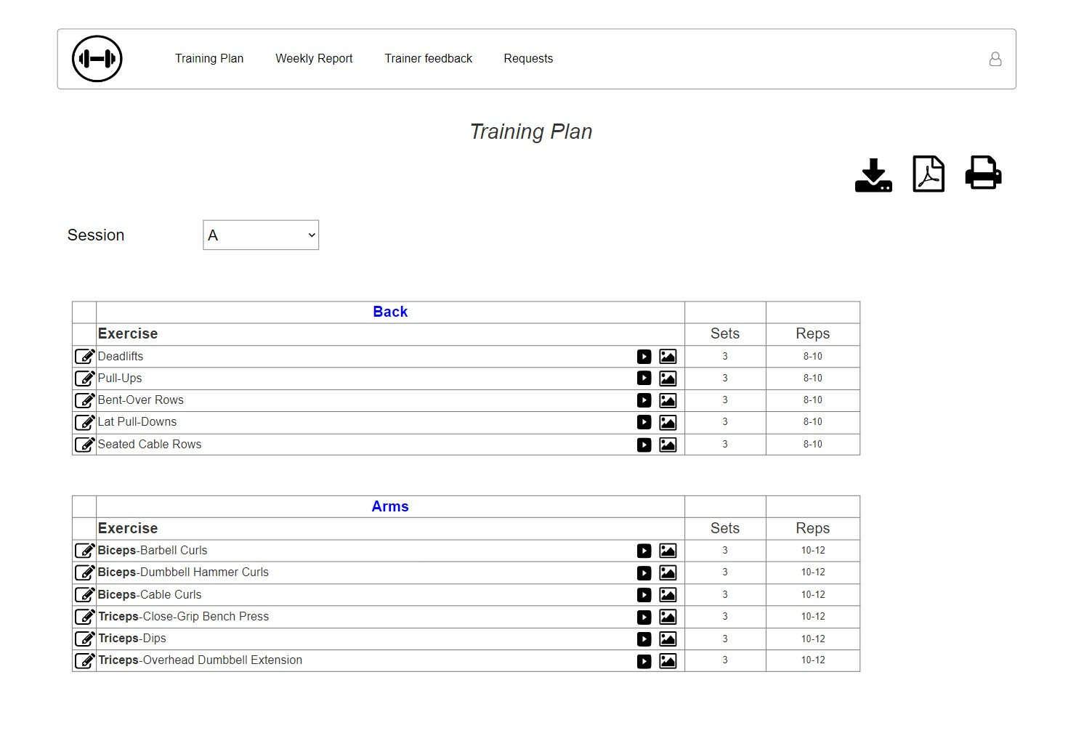
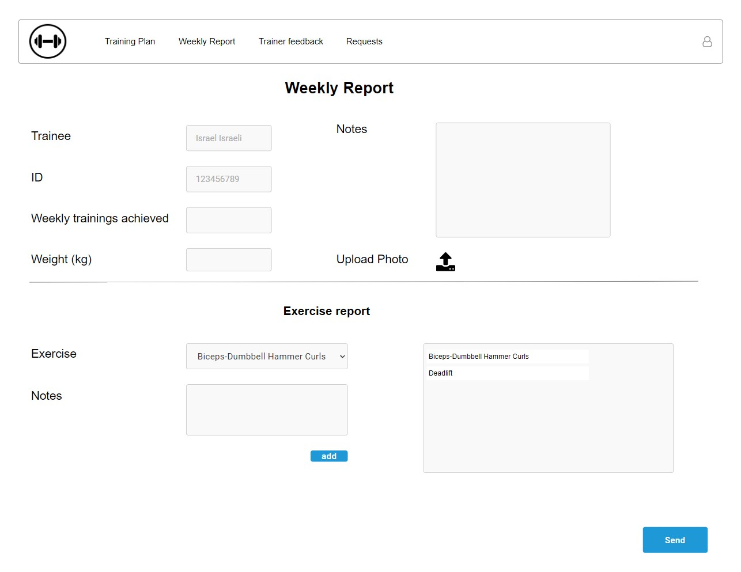
Interface

Slide 12
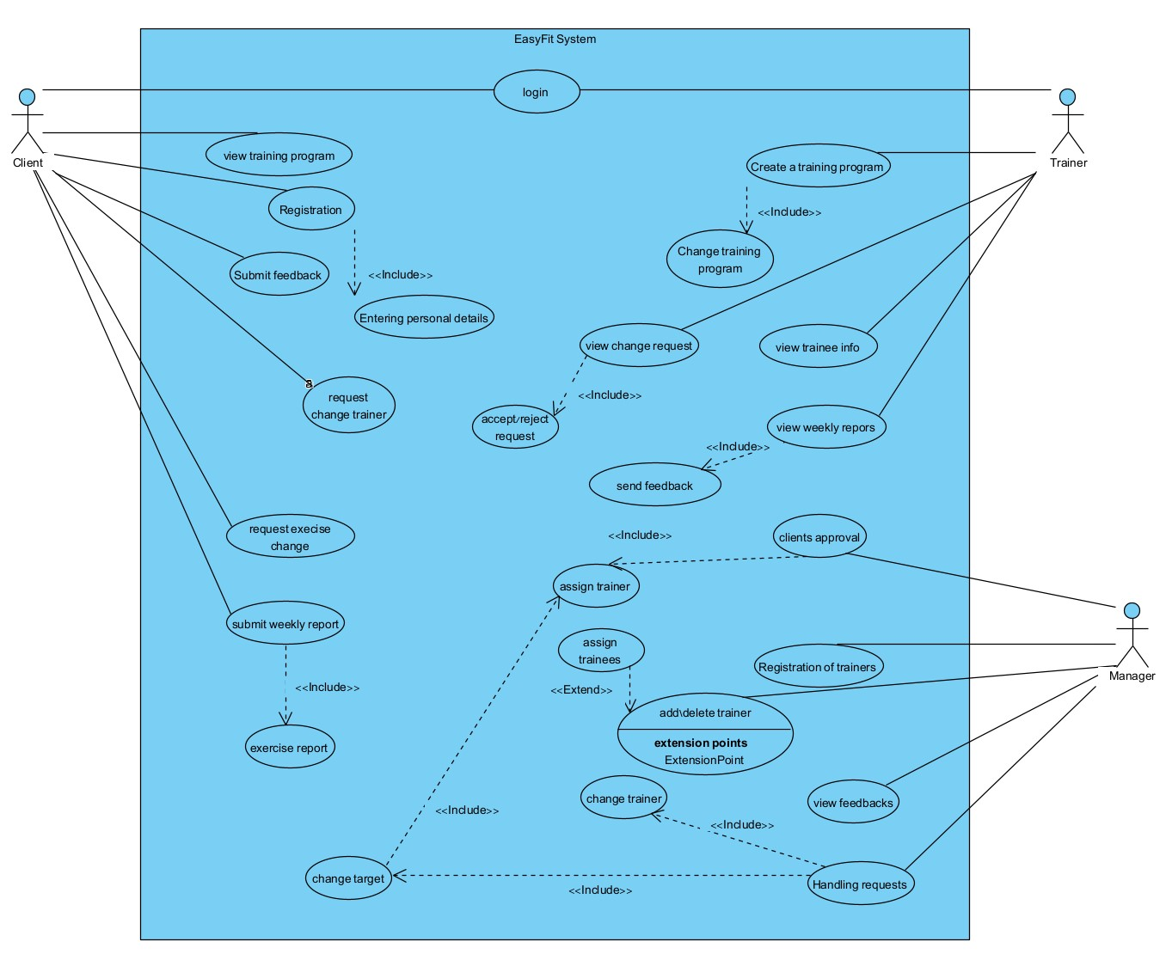
Diagrams
Use Case Diagram

Slide 13
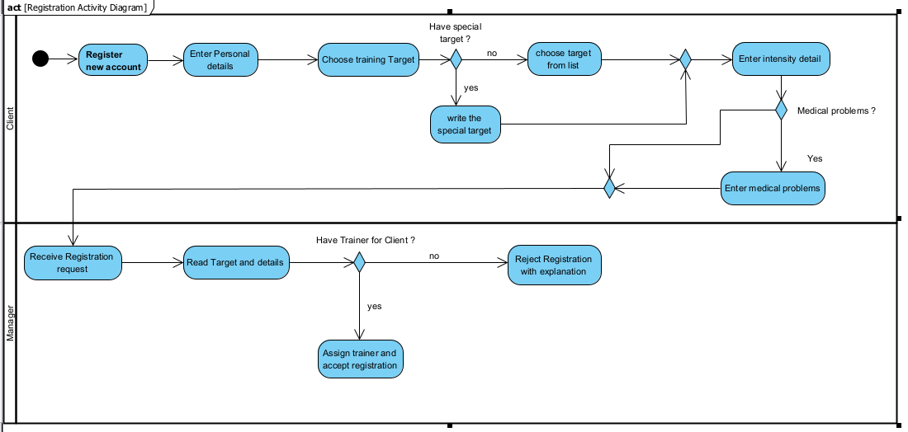
Diagrams
Activity (Register) Diagram

Slide 14
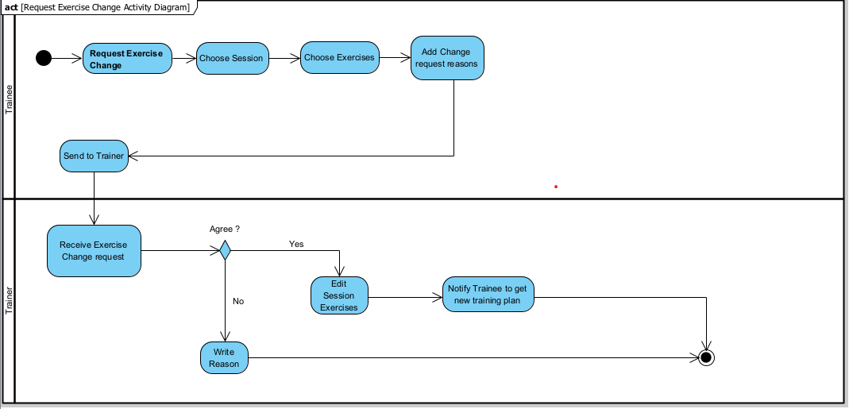
Diagrams
Activity (Request Exercise Change) Diagram

Slide 15
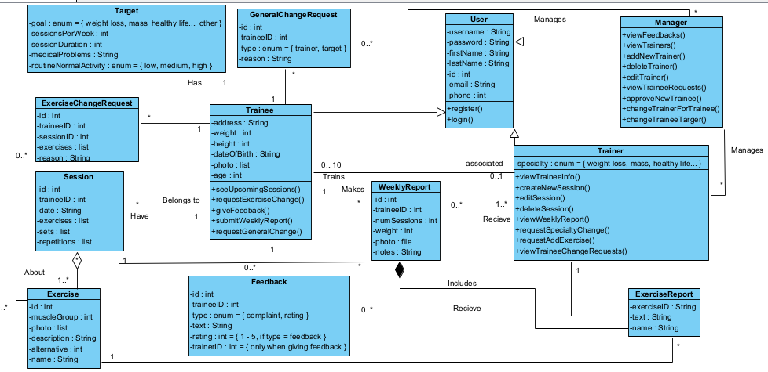
Diagrams
Class Diagram

Slide 16
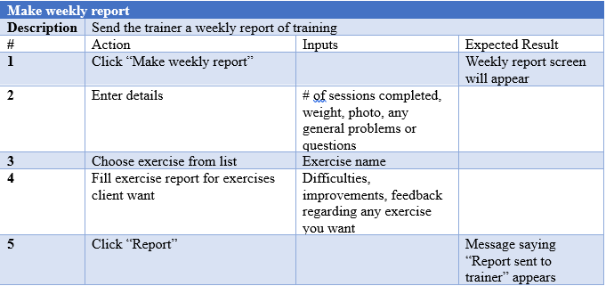
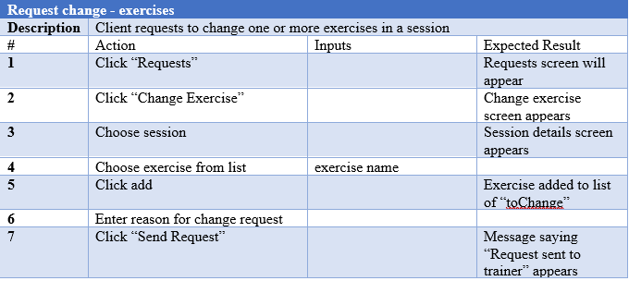
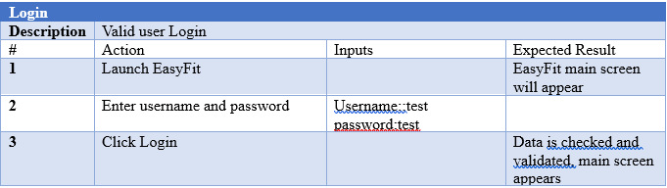
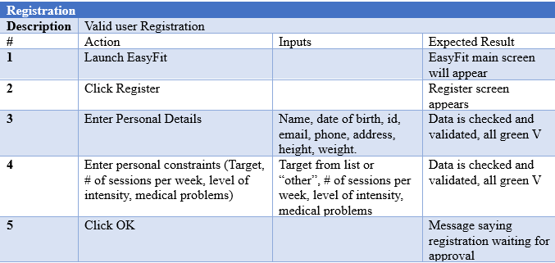
Testing Plan

Slide 17
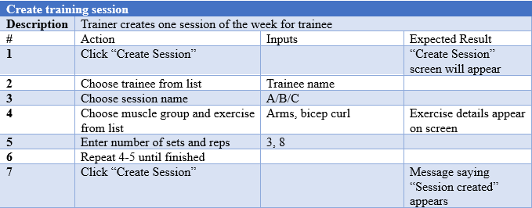
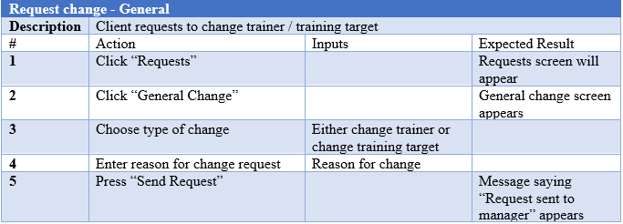
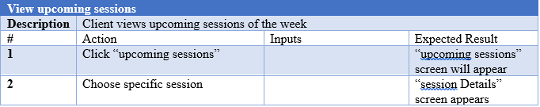
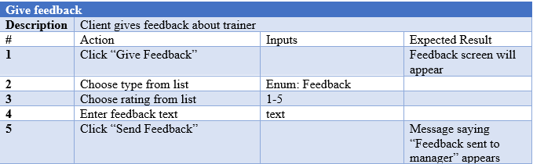
Testing Plan

Slide 18
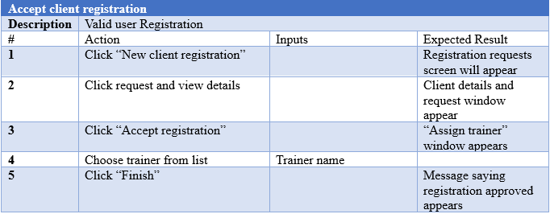
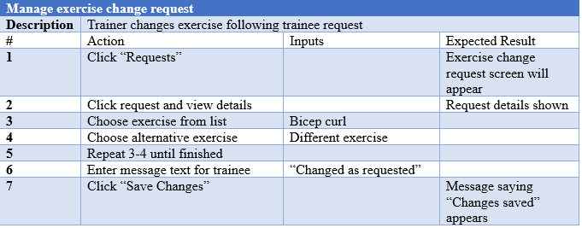
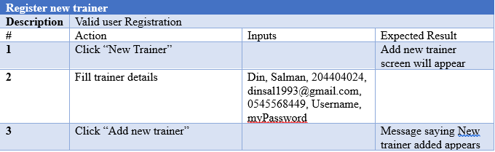
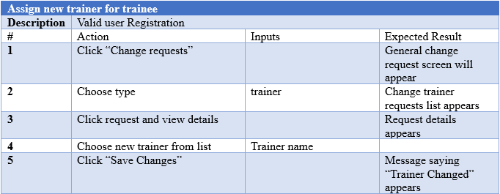
Testing Plan

Slide 19
Thank You!
Eran Jehassy
Din Salman

